Slide 1


Flight-Ready Electric Feed System
MME 2018-2019 Capstone Project
SPONSORS:
Portland State Aerospace Society
Oregon NASA Space Grant Consortium
INDUSTRY ADVISOR:
Andrew Greenberg
ACADEMIC ADVISOR:
Baldur Steingrimsson
Notes:
Maybe break up into two slides??

Slide 2

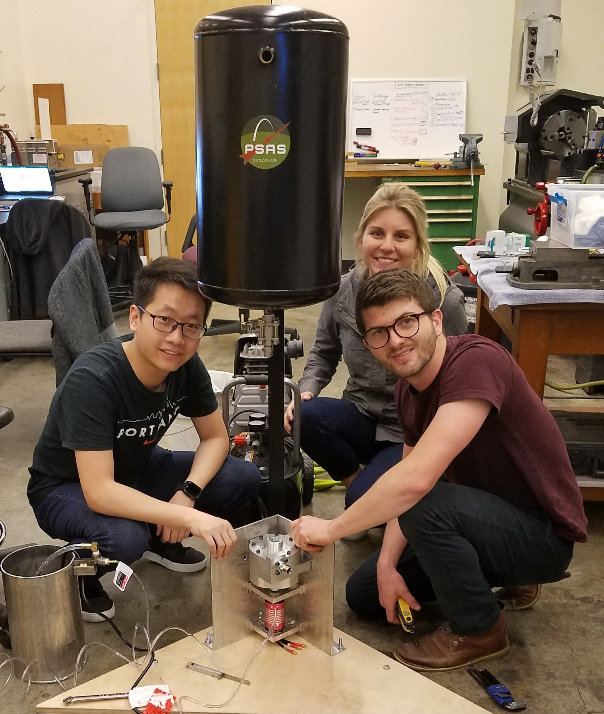
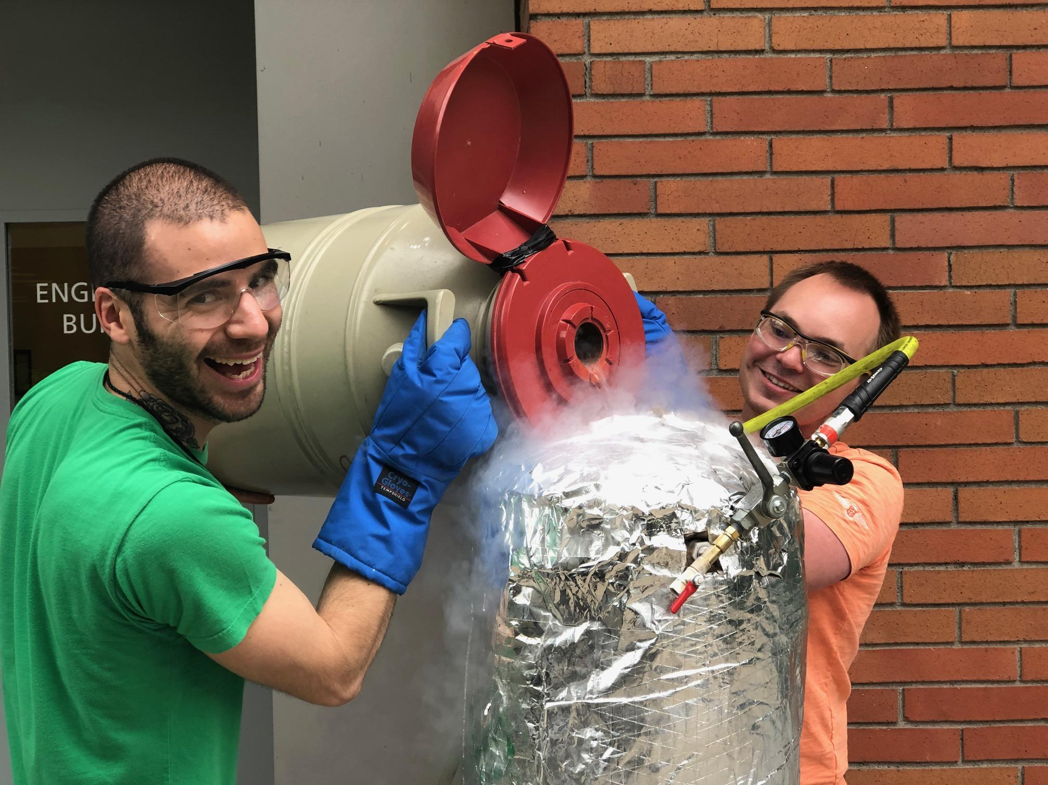
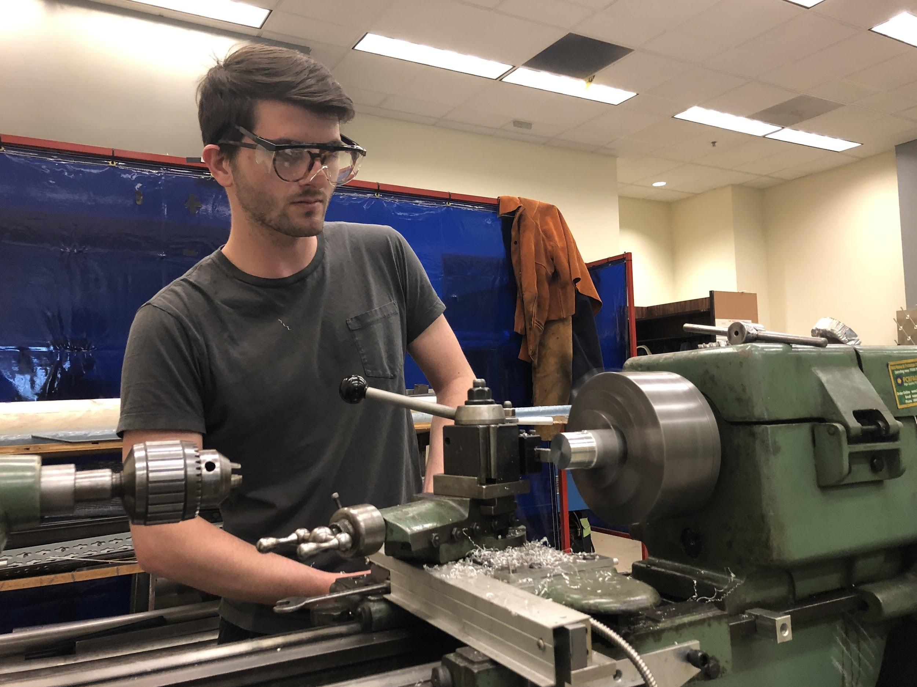
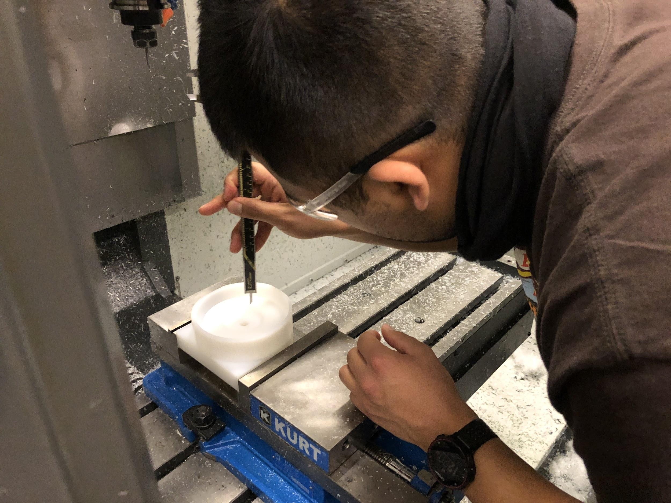
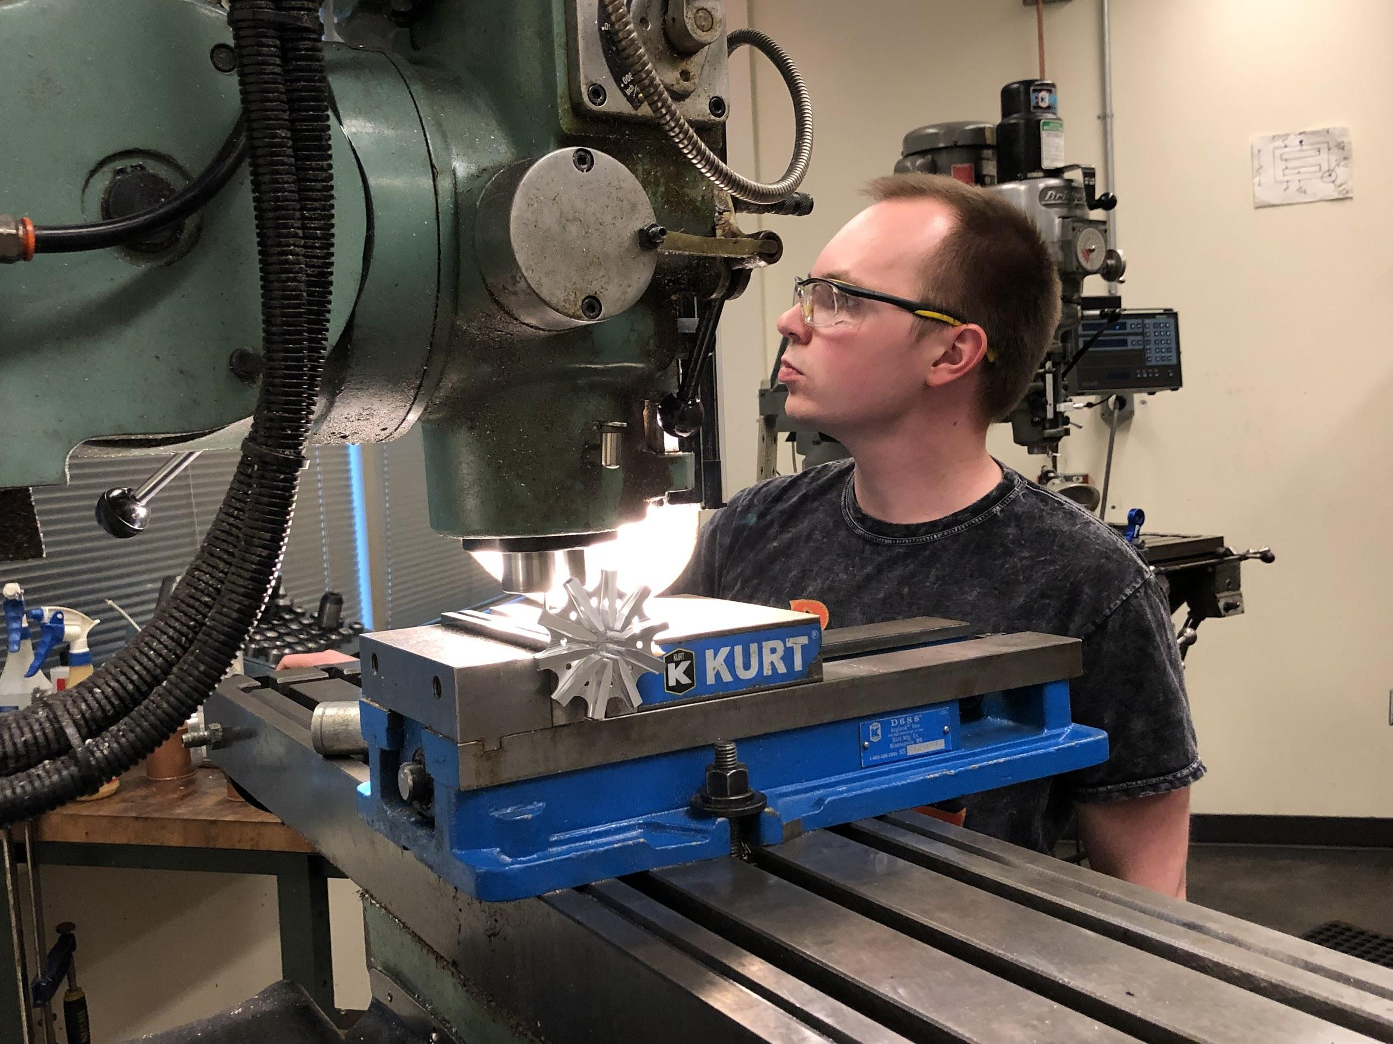
TEAM MEMBERS
Shayli Elrod | Julio Garcia | Henry Ju | Nick Sheldon | Jonas Mendoza | Philip Wahl

Slide 3
PRESENTATION AGENDA
Project Proposal
Project Requirements
Design
Manufacturing
Results
Continuation

Slide 4

CAPSTONE PROPOSAL
PROJECT SPONSOR
Portland State Aerospace Society
PROJECT PROPOSAL
Develop an Electric Feed System to pump two propellants for
a liquid rocket engine.

Slide 5
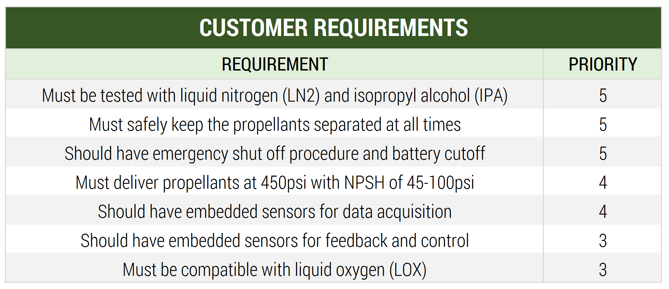
CUSTOMER REQUIREMENTS

Slide 6
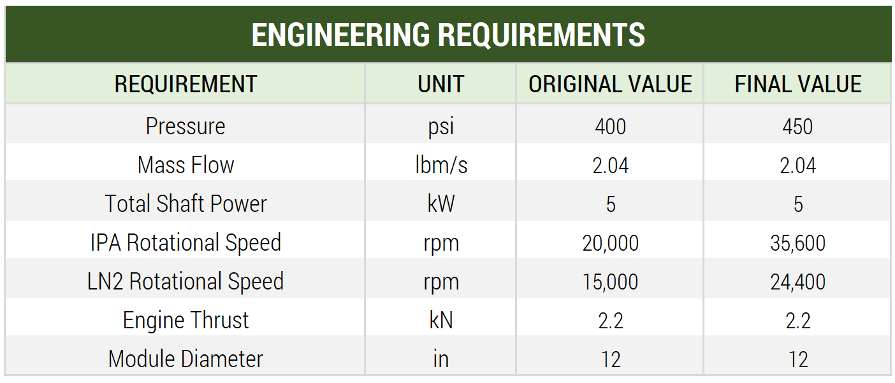
ENGINEERING REQUIREMENTS

Slide 7
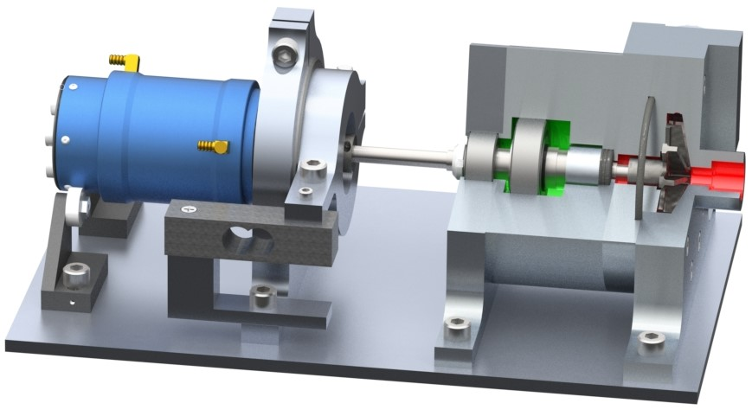
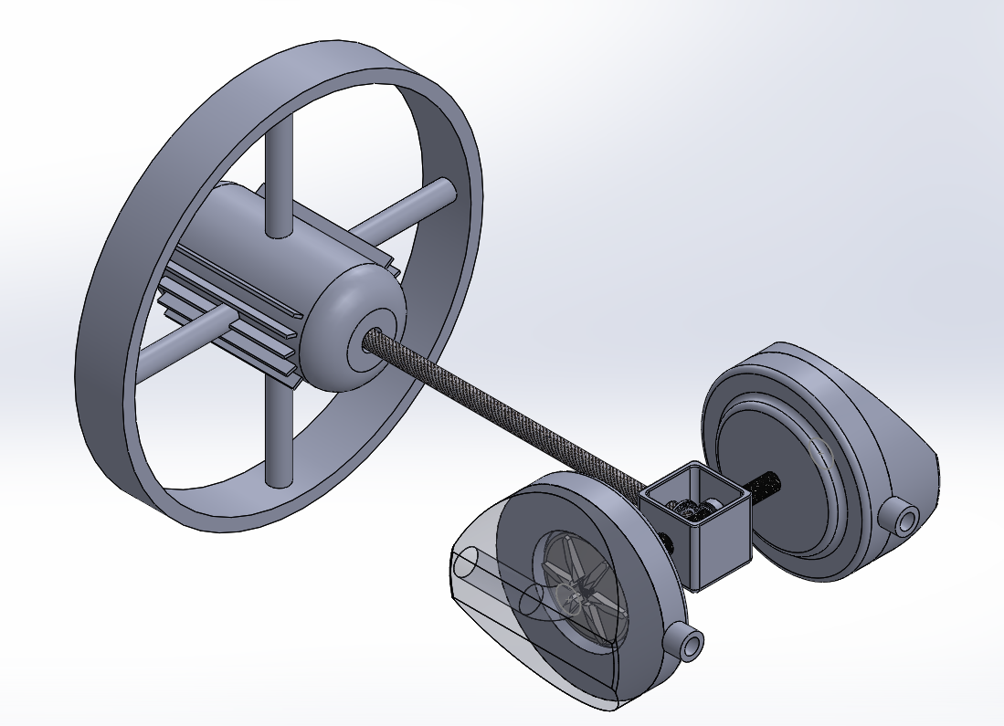
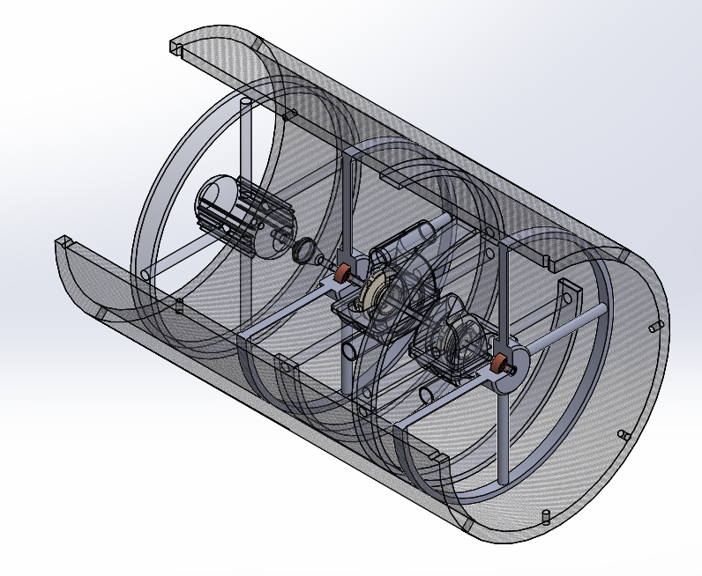
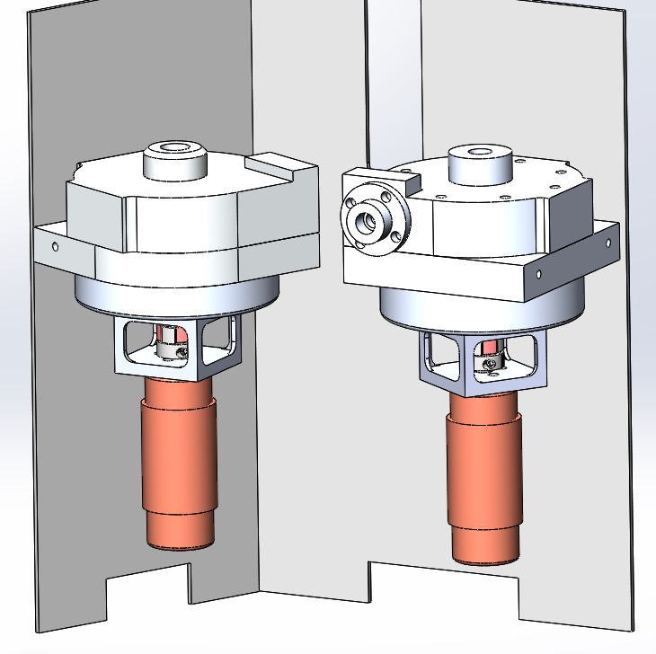
DESIGN
CONCEPTION
Notes:
Maybe find a better axial in line photo (middle one)

Slide 8
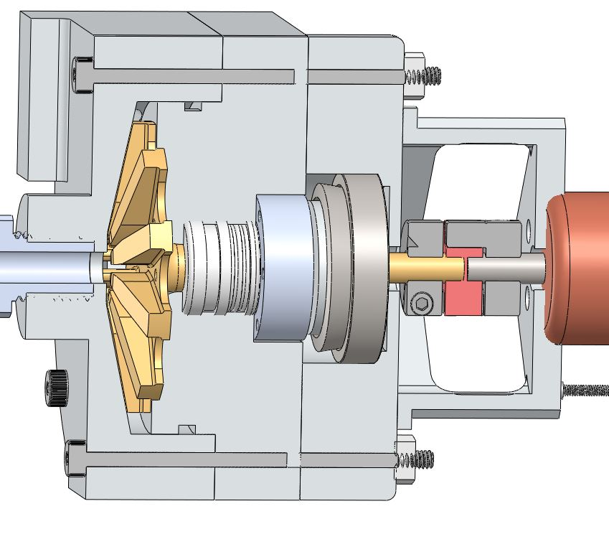
DESIGN
IPA PUMP
3.0” Impeller Diameter
35,700 RPM
1.7 kW Power
FlowServe Type 15 Seal
Stainless Thrust Bearing
6061 Aluminum Case and Impeller

Slide 9
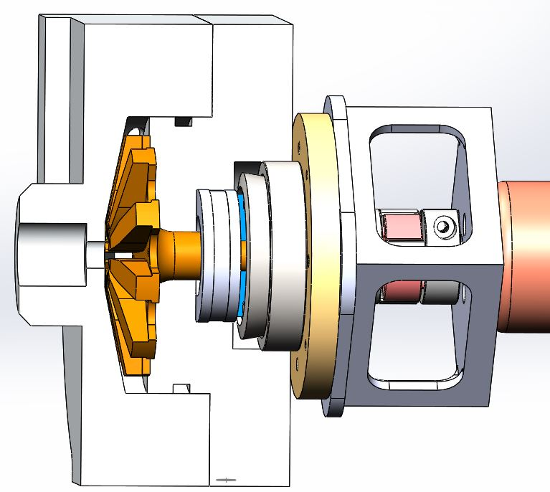
DESIGN
LOX PUMP
2.5” Impeller Diameter
24,300 RPM
2.1 kW Power
Teflon Seal
BOCA Ceramic Bearing
Stainless Thrust Bearing
6061 Aluminum Case and Impeller

Slide 10
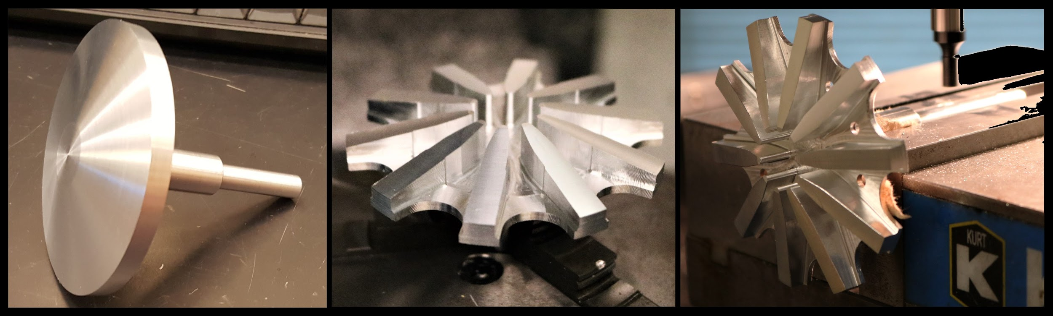
MANUFACTURING
Impeller

Slide 11
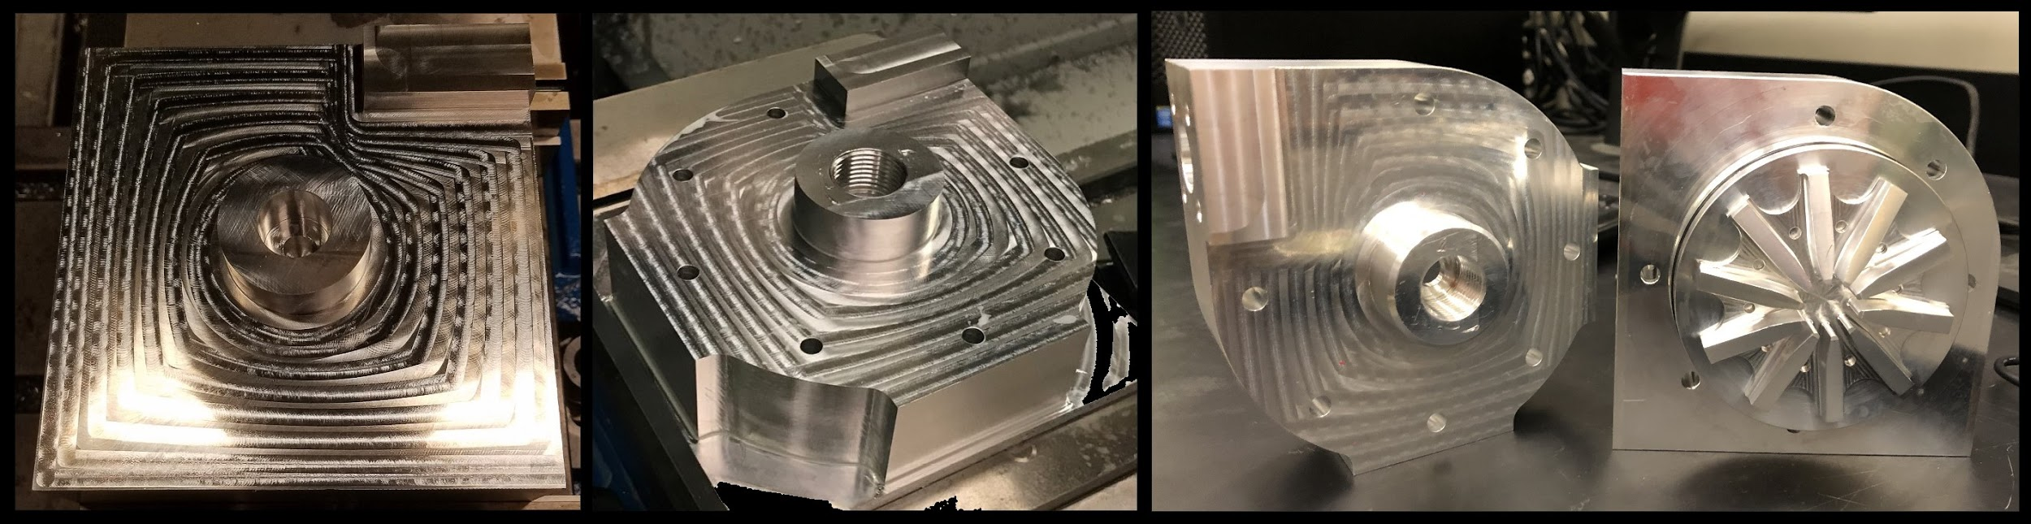
MANUFACTURING
Pump Case

Slide 12

RESULTS

Slide 13
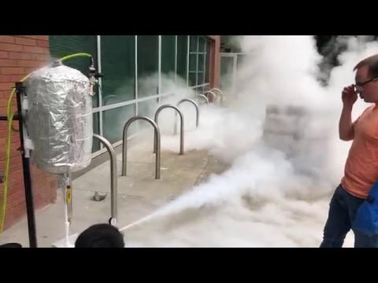
RESULTS

Slide 14
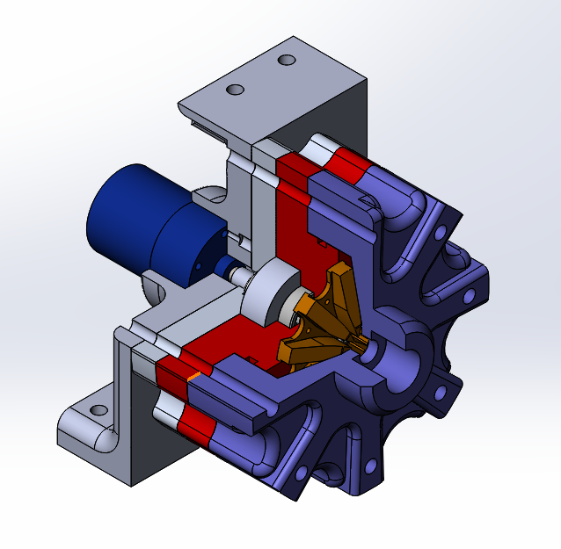
CONTINUATION
WEIGHT REDUCTION
Case Geometry
Integrated Motor Assembly
Reduce Hardware

Slide 15
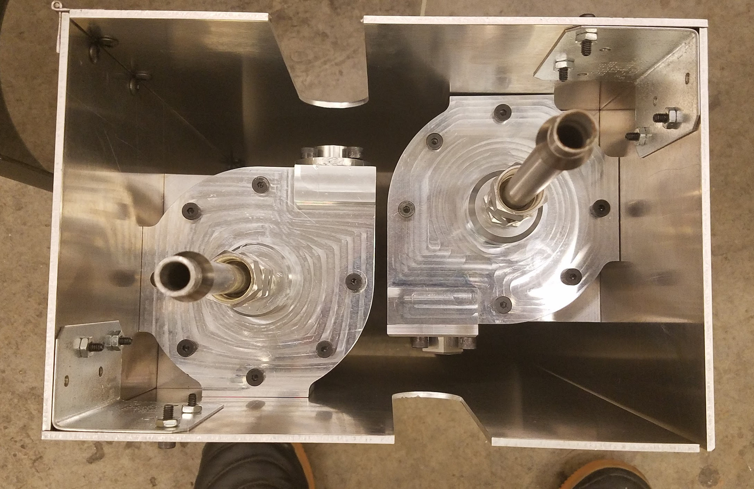
CONTINUATION
AIRFRAME INTEGRATION
Develop mounting system
Design Internal Piping
Identify Flow losses
Sensor integration

Slide 16

THANK YOU
Portland State Aerospace Society
Oregon Space Grant Consortium
Andrew Greenberg
Rebecca Routson
Mike Chuning
Baldur Steingrimsson
Portland State MME Department

